Slide 1
Aws ECS
ow

Slide 2

ECS

Slide 3
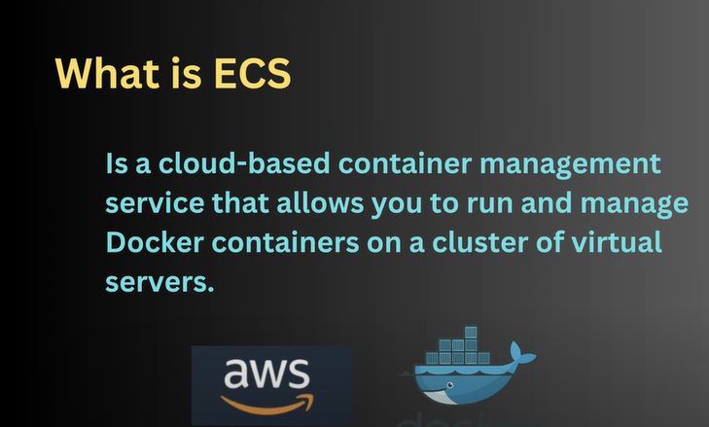
Definition

Slide 4
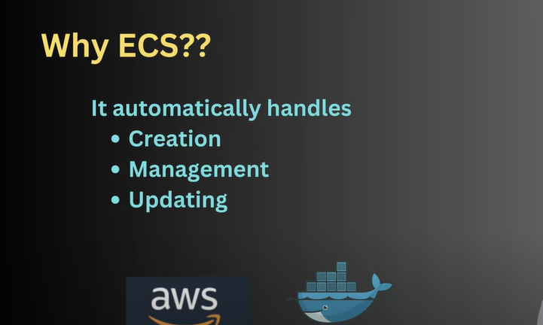
Why ecs

Slide 5
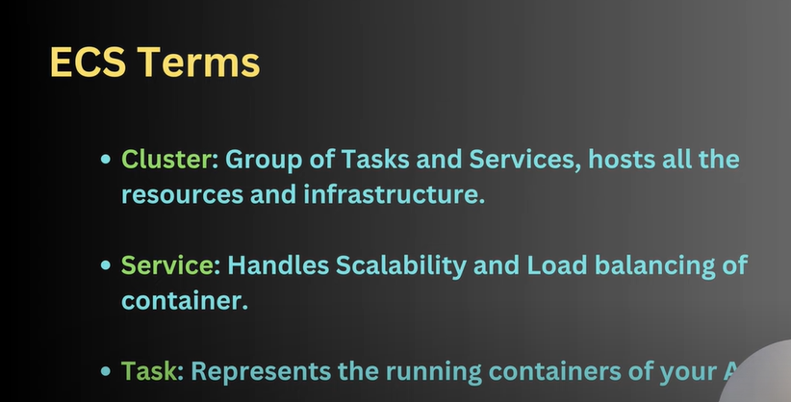
terms

Slide 6
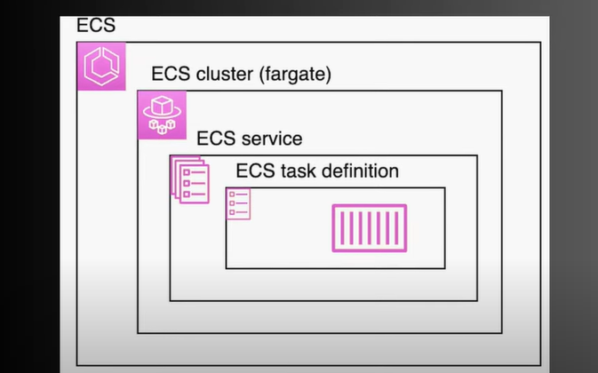
..

Slide 7
lab

